Slide 1


DECRYPT
AUDIT
25.02.2025
Loann KAIKA
Clément SARAZIN

Slide 2
Sommaire
Context
Deliverables and goals
Product presentation
Marketing and sales

Slide 3
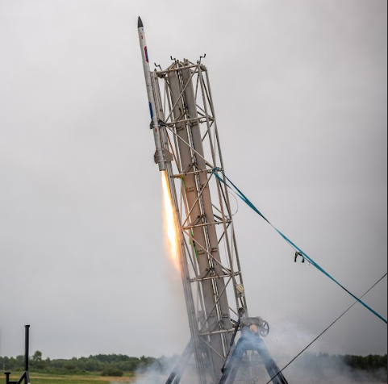
Context
moDular and Embedded platform for Control and telemetRY of aerosPace sysTem

Slide 4
II. Deliverables and goals
Deliverables
Goals
Guide and documents
Power board
Sequencer board
Telemetry board
Software : telemetry app

Slide 5
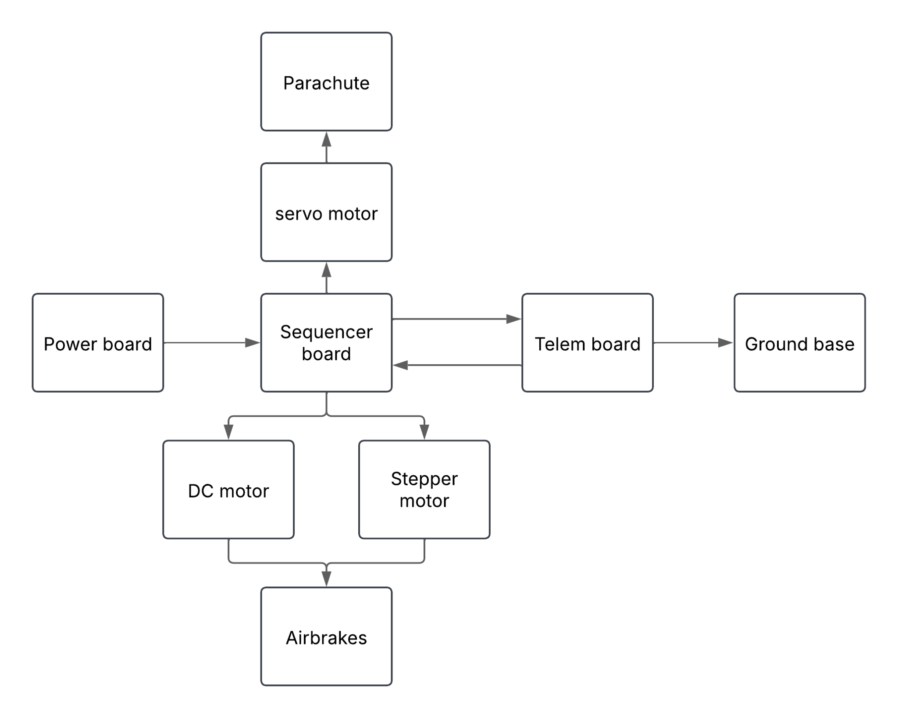
III. Product presentation
Example of a product diagram
Main layout

Slide 6
III. Product presentation
Power board
The board is made to power all of the boards

Slide 7
III. Product presentation
Sequencer board
This board is used to trigger the parachute hatch and the airbrakes at the right time

Slide 8
III. Product presentation
Telemetry board
Gathering data with sensors
Storing data
Sending data using communication module
Using GPS to find the board

Slide 9
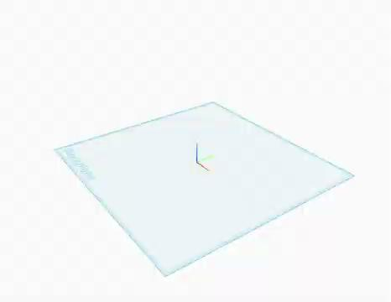
III. Product presentation

Slide 10
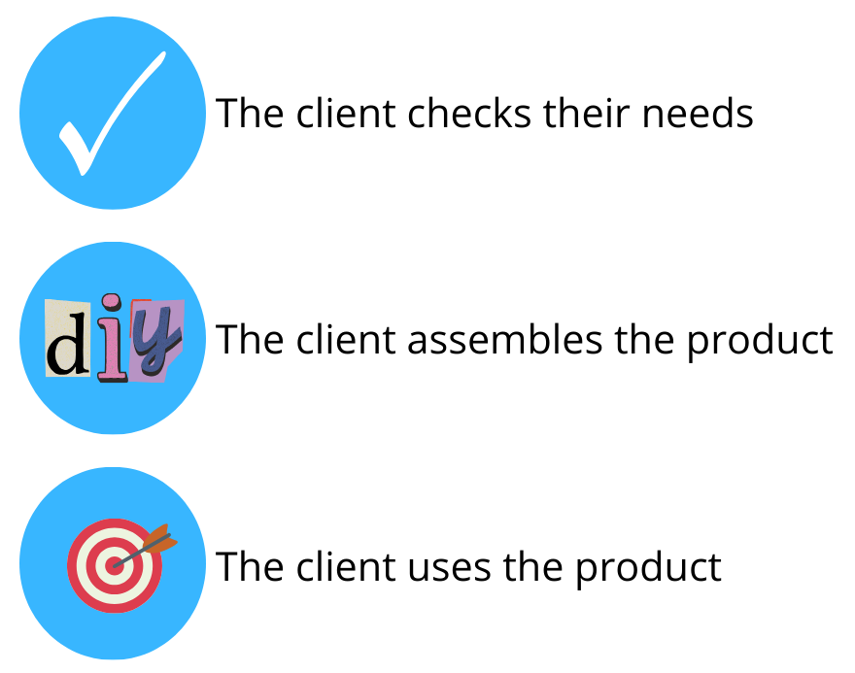
IV. Marketing and sales : user scenario

Slide 11
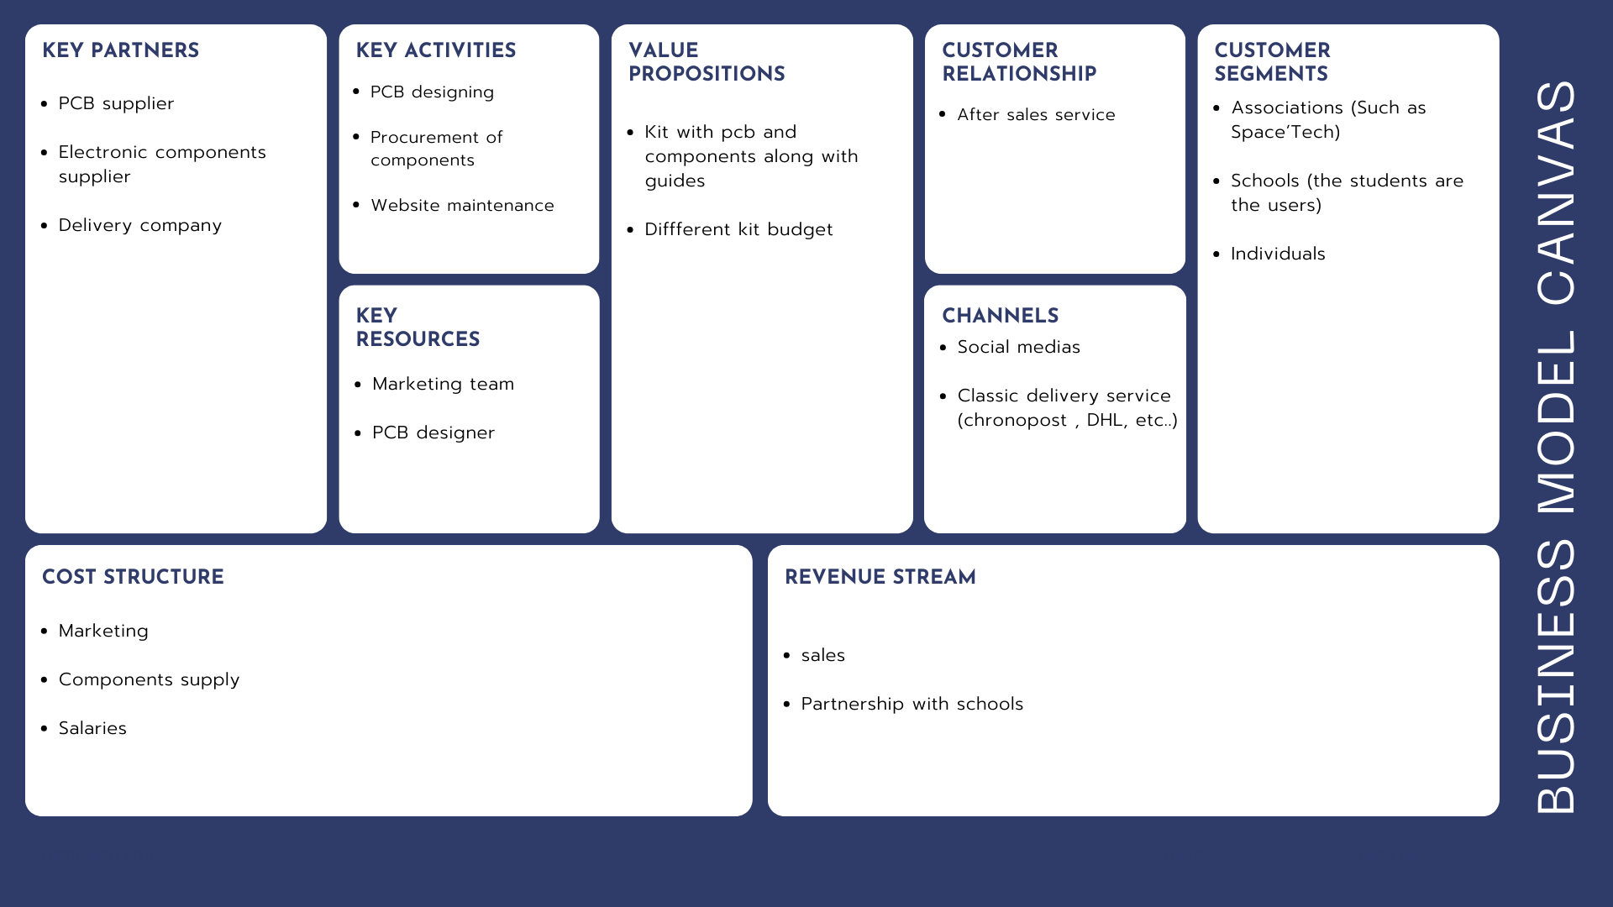
IV. Marketing and sales : business model canva

Slide 12
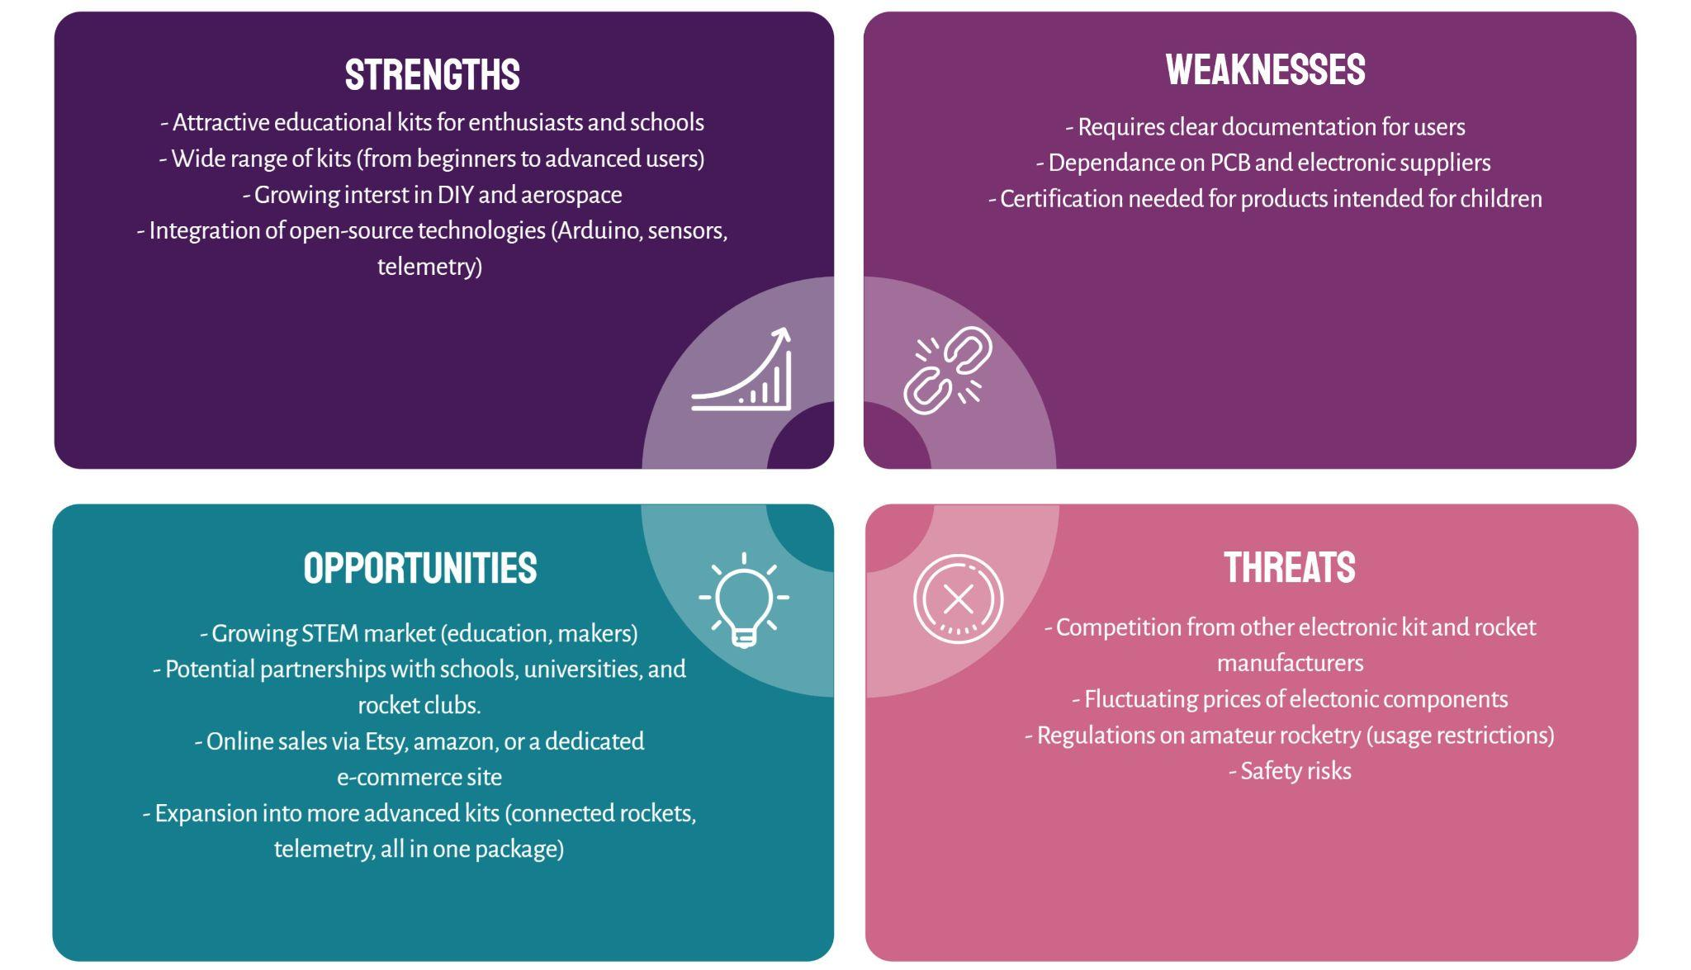
IV. Marketing and sales : SWOT

Slide 13
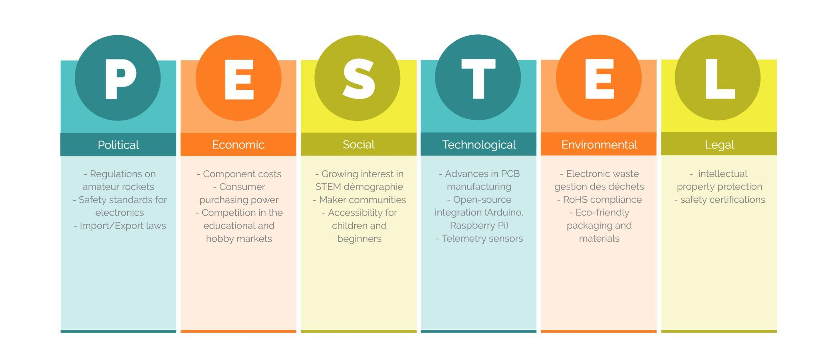
IV. Marketing and sales : PESTEL

Slide 14
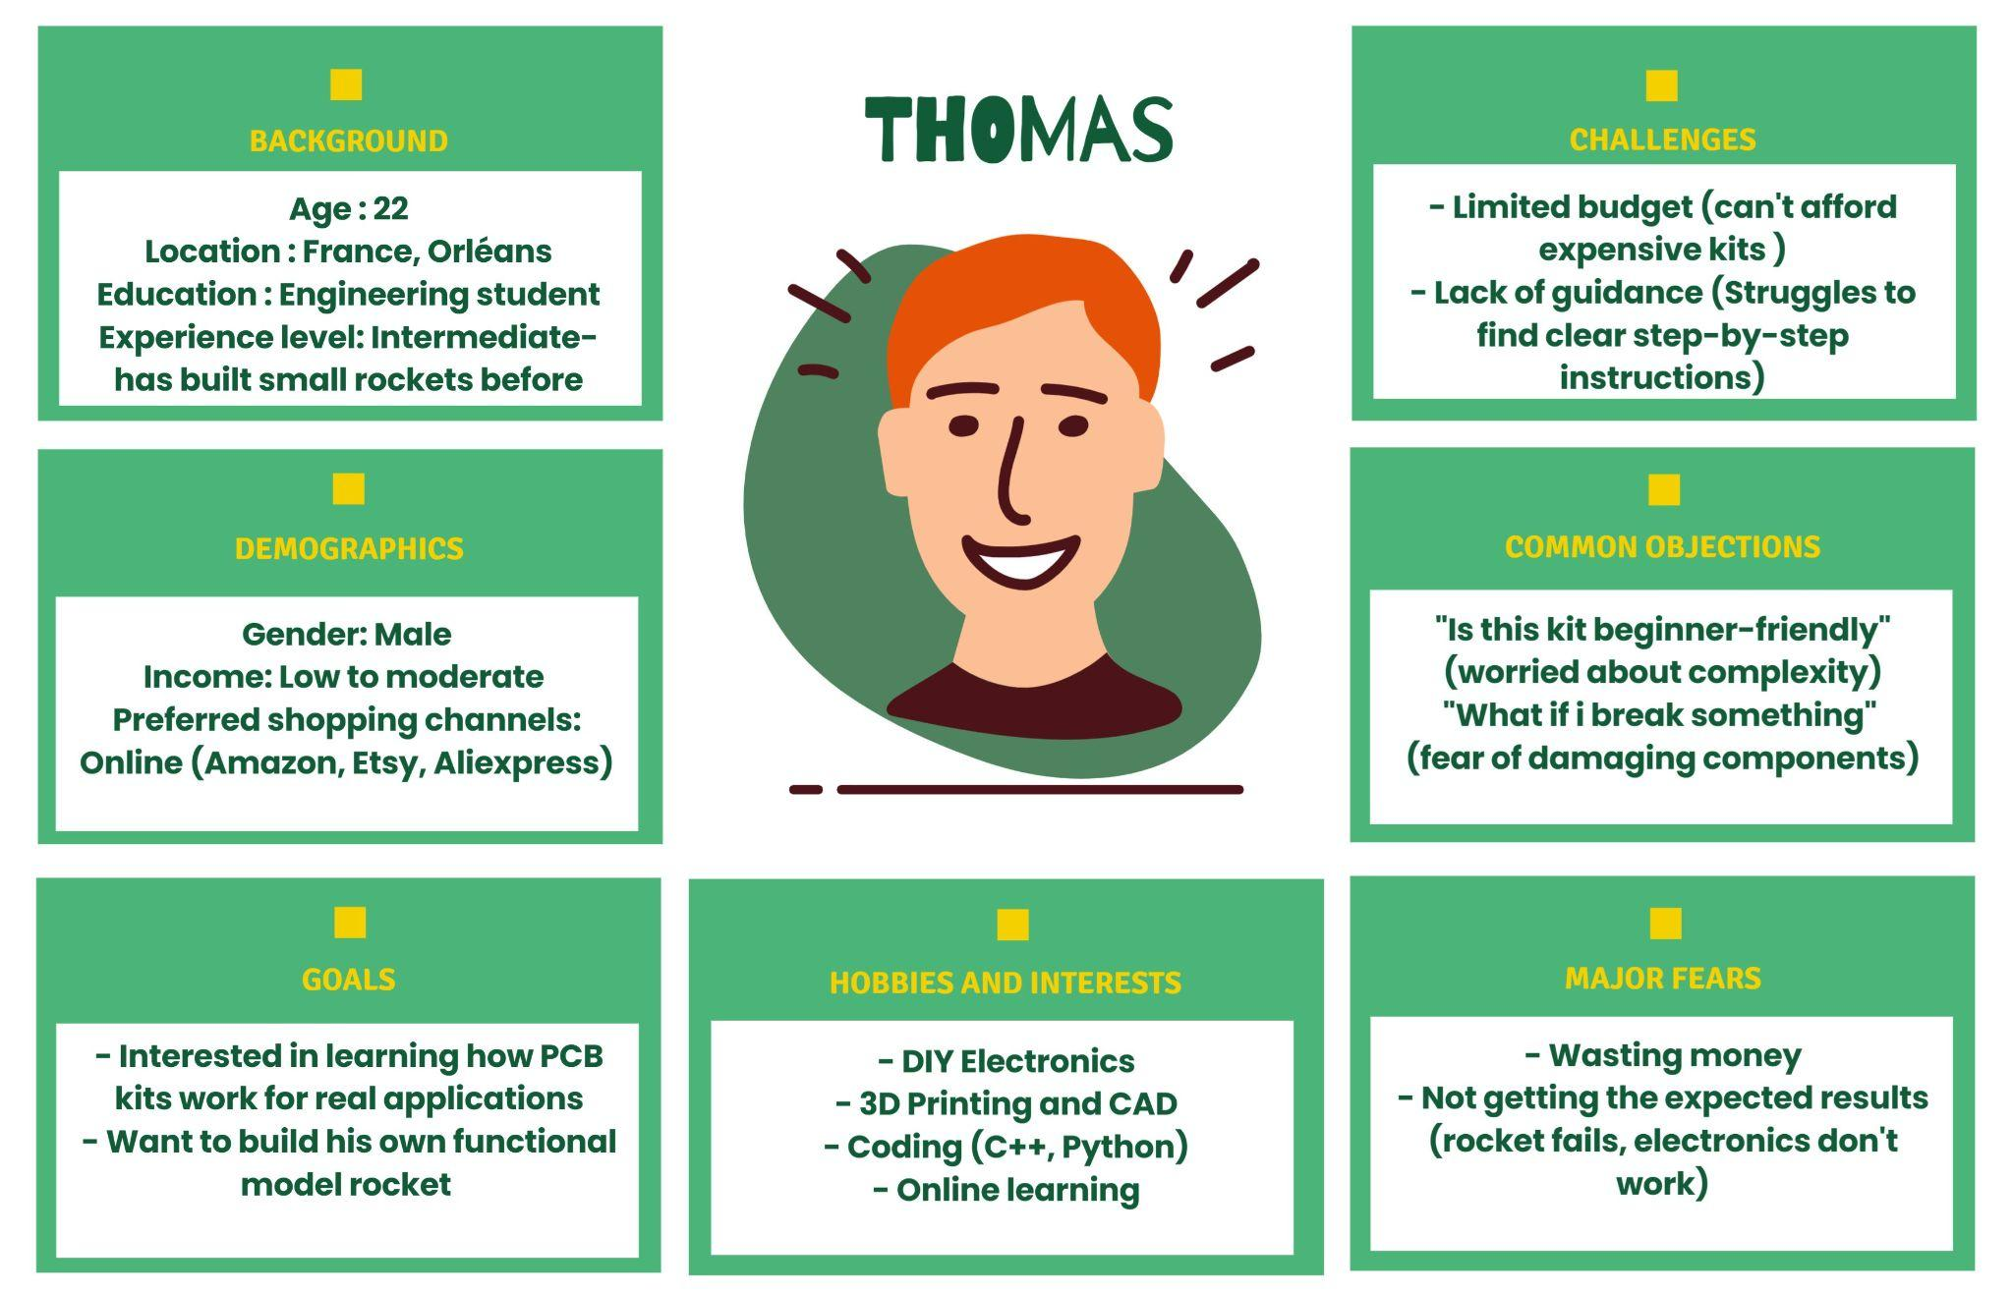
IV. Marketing and sales : Persona

Slide 15
IV. Marketing and sales : Forecast table
Category | Basic Kit (€) | Advanced Kit (€)
PCB Manufacturing | 5 | 10
Electronic Components | 10 | 30
Assembly Costs | 3 | 8
Packaging | 2 | 3
Shipping Costs | 10 | 15
Marketing | 5 | 10
Total Costs | 35 | 76
Selling Price per Kit | 50 | 120
Estimated Sales (units) | 500 | 300
Total Revenue | 25000 | 36000
Projected Profit | 7500 | 14400

Slide 16
Conclusion

